Slide 1

CyberZoo III
By Karina & Li
2024-03-12

Slide 2
Agenda
Tasks
Diagrams
Demonstration

Slide 3

Tasks
Define New Models
Implement A Map
Manage Tours
Interaction and Feedback

Slide 4
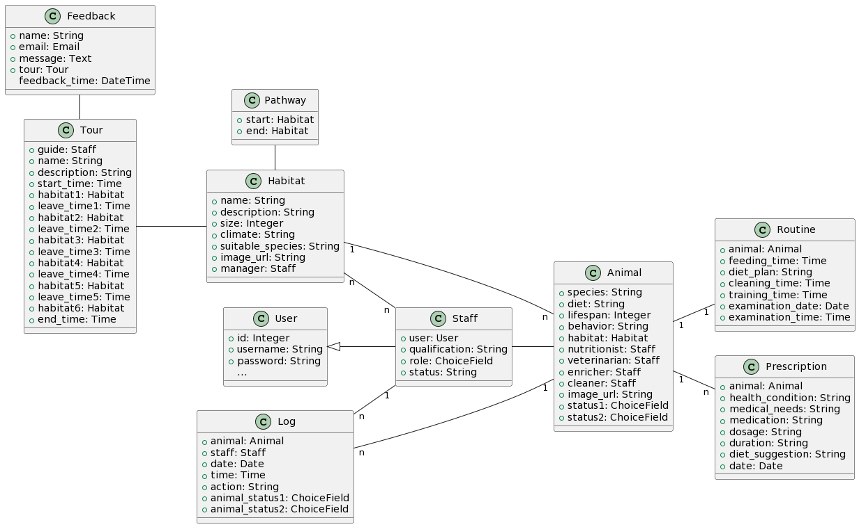

Slide 5
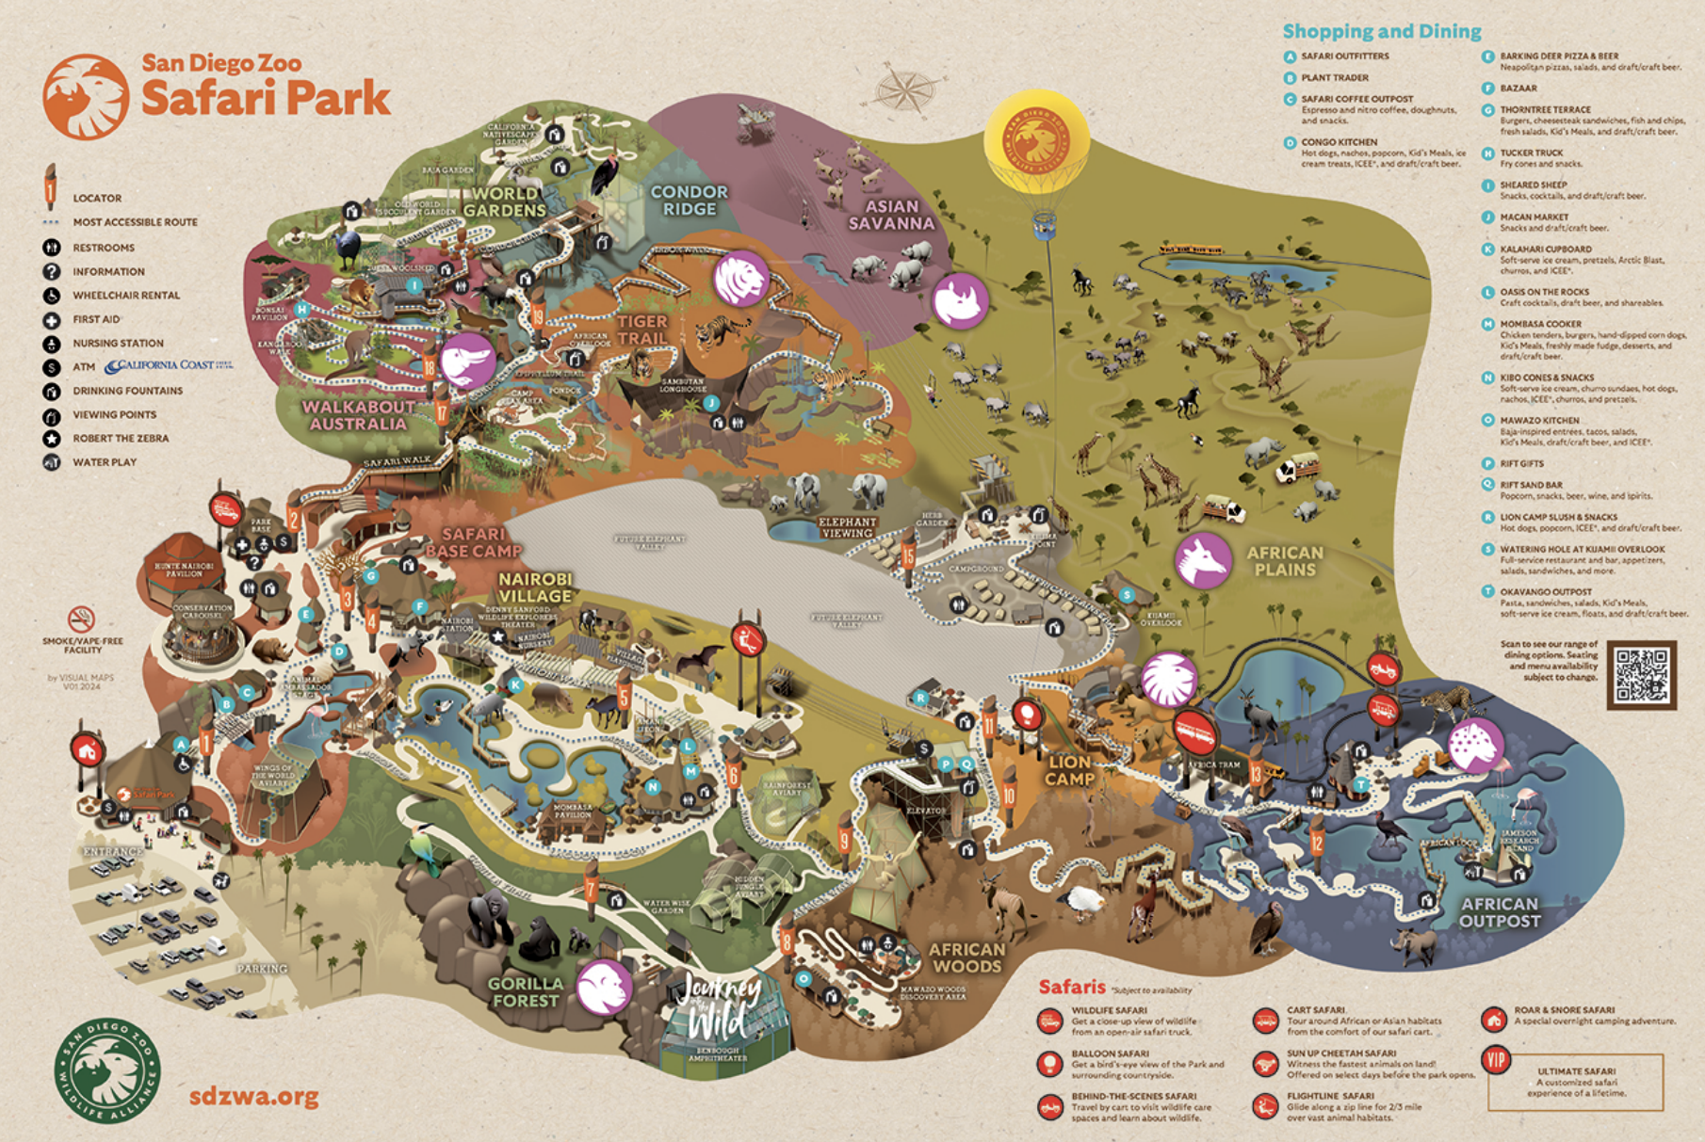
Logic Map

Slide 6
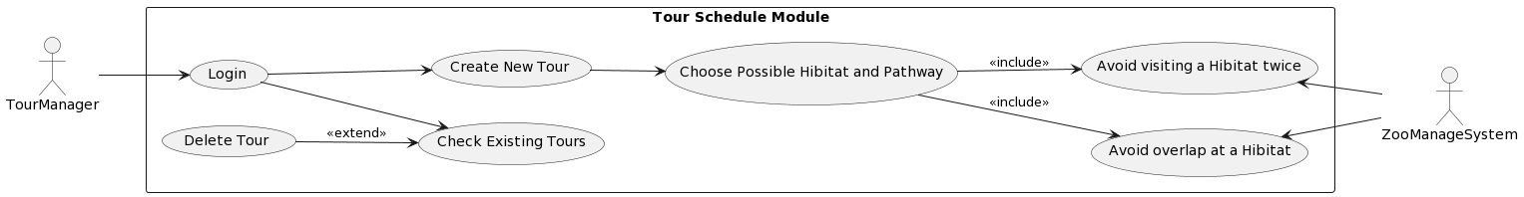
Tour Management Use Case Diagram

Slide 7
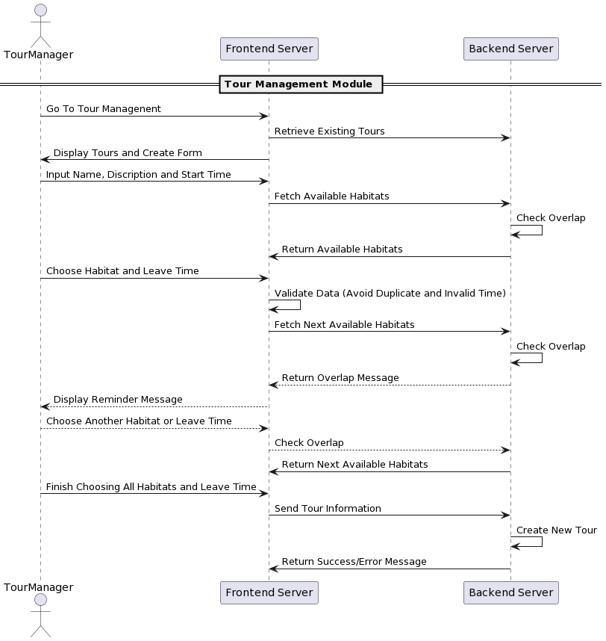
Tour Management Sequence Diagram

Slide 8
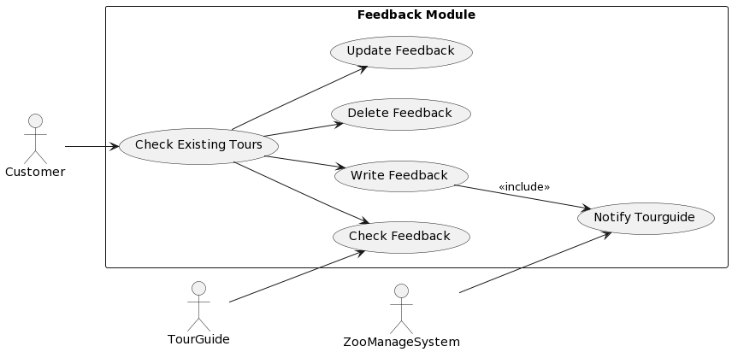
Feedback Use Case Diagram

Slide 9
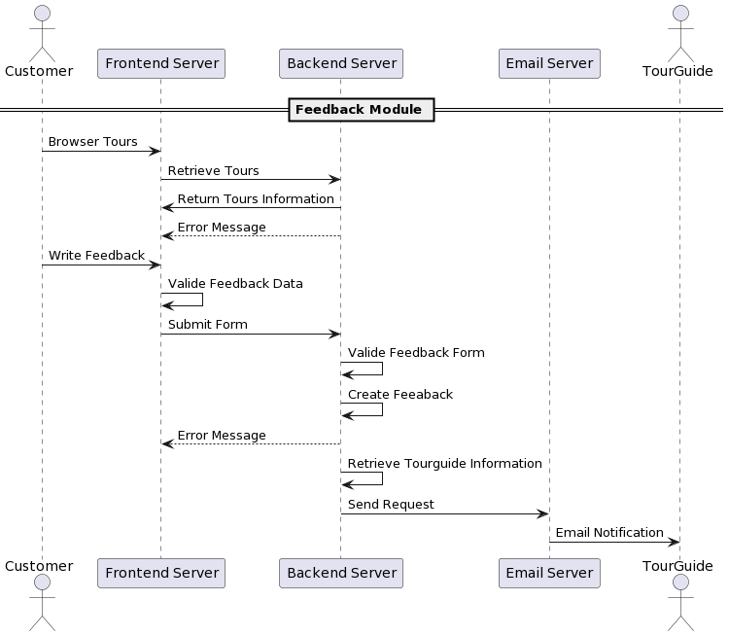
Create Feedback Sequence Diagram
Similar for update & delete

Slide 10
Please See Demonstration

